Slide 1



ARDUINO COURSE • LECTURE 1
Introduction to Embedded Systems
Hardware architecture, electronic components, and Arduino C programming.

Slide 2


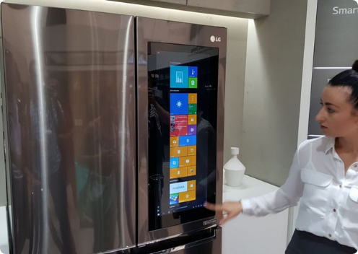
01 / DEFINITION
What is an Embedded System?
Hardware Combo: Specific software integration.
Targeted Design: Dedicated single function.
System Integration: Housed within larger machinery.

Slide 3
02 / ARCHITECTURE
The Brain of the System
Microprocessor
Microcontroller
CPU processing only.
Integrated CPU unit.
Requires external memory.
On-board memory modules.
Requires external I/O ports.
Built-in I/O capabilities.

Slide 4
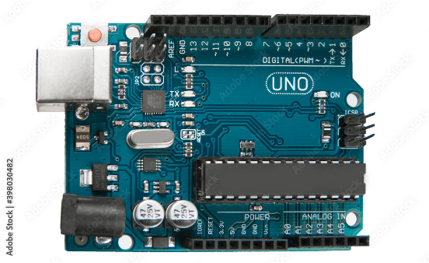
03 / PLATFORM
What is Arduino?
Open-source ecosystem.
Hardware and software integration.
Arduino C language.
Simplified C++ derivative.
Micro-computer board.
Compact computing solution.

Slide 5



Arduino Uno Anatomy
Power Pins
Digital I/O
Analog In
Vin, GND, 5V, 3.3V.
14 configurable logic pins.
6 dedicated sensor inputs.

Slide 6



04 / COMPONENTS
The Hardware Toolkit
LEDs
Resistors
Jumpers
Light emitting diode indicators.
Current limiting circuit protectors.
M-M interface routing cables.

Slide 7
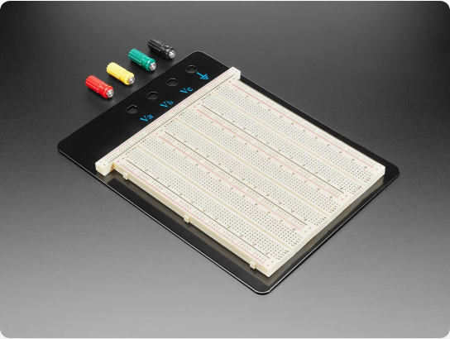
Solderless Prototyping
Power Rails.
Continuous horizontal power connections.
Component Strips.
Vertical five-pin linked segments.
Central Divider.
IC isolation trench barrier.

Slide 8
05 / CALCULATION
Protecting Your Circuit
R = V / I
200Ω
5V
2V
15mA
Source
LED Drop
Safe Current

Slide 9
Arduino IDE Workflow
1. Write Code
2. Compile
3. Upload
Define setup and loop.
Verify syntax correctness.
Transfer compiled binary.

Slide 10
TASK 01
void setup() {
pinMode(13, OUTPUT); // Init pin 13
}
void loop() {
digitalWrite(13, HIGH); // LED on
delay(1000); // Wait 1s
digitalWrite(13, LOW); // LED off
delay(1000); // Wait 1s
}
Blinking LED
Connect LED to Pin 13.
Configure output mode.
Alternate high and low states.

Slide 11
Practice Challenges
Sequence 3 LEDs
Sequence 5 LEDs
Turn on X, wait 0.1s.
Turn on A & E, wait 0.08s.
Turn on Y, wait 0.1s.
Turn on B & D, wait 0.08s.
Turn on Z, wait 0.1s.
Turn on C, wait 0.08s.

Slide 12



Image Sources
https://i.pcmag.com/imagery/articles/07MsRA3ChcNUBV1iESwEjNQ-3..v1569484114.jpg
Source: www.pcmag.com
https://as1.ftcdn.net/v2/jpg/03/98/03/04/1000_F_398030482_H5Gq6Z9jvHLzv5cDsJnV9UKcqdrLFS9N.jpg
Source: www.posters.cz
https://cdn-shop.adafruit.com/970x728/443-03.jpg
Source: www.adafruit.com

